Slide 2
Pathfinder AI (Implementing path finding algorithms for route planning)
Minor Project Synopsis Presentation
SUBMITTED BY:-
Keertivallabh Sharma R2142220539 FSAI B-1
Jyotiraditya Singh R2142220530 FSAI B-1
Shrey Sharma R2142220169 FSAI B-1
Rishav Singh R2142220149 FSAI B-1
MENTORED BY:-
Dr. Panduranga Raviteja

Slide 3
Abstract
The rapid growth of urban areas and the increasing need for efficient transportation infrastructure demand innovative solutions for road network connection. Our project aims to develop a prototype application that uses a mix of pathfinding algorithms to determine the optimal route for constructing national highways or roads between selected cities. The proposed solution will enable users to interactively upload city-wide maps, choose specific cities to connect, and mark important locations such as hospitals, offices, government buildings, airports, and stations.

Slide 4
Introduction
Project Focus: Develop a prototype application for optimal route planning for national highways and roads as well as unmarked terrain.
Objective: Utilize a modified Dijkstra's algorithm to determine the most efficient routes between selected cities.
User Interaction:
Upload city-wide maps.
Select locations to connect and other binary inputs.
Mark critical locations like hospitals, offices, airports, and government buildings.
Outcome: Assist users in making data-driven, cost-effective decisions for route planning.

Slide 5
Objectives
• To develop a prototype application that enables users to upload and interact with city-wide maps.
• To allow users to select specific cities and mark important locations (e.g., hospitals, government buildings, airports, stations) on the map.
• To implement modified versions of path determining algorithms like (A*, djikstra etc.) for determining optimal routes for highway or road construction.
• To optimize route planning based on factors like distance, traffic density, and priority of marked locations.
• To provide a tool to make informed decisions for efficient route planning.

Slide 6
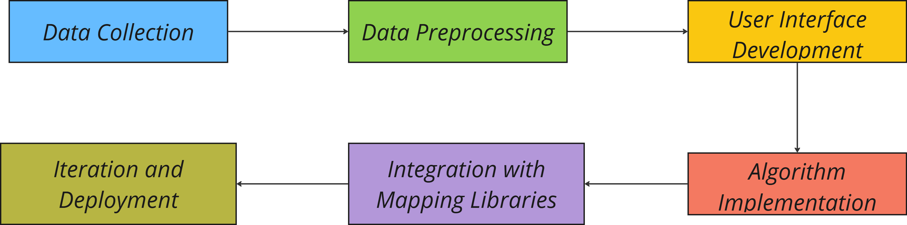
Methodology
The methodology includes collecting and preprocessing city maps, developing a user interface, implementing modified algorithms for route optimization, integrating mapping libraries for visualization, and refining the application based on feedback before deployment.

Slide 7
Tools and Technologies
• Programming Languages: JavaScript, Python
• Front-End Development: React.js or Angular for creating an interactive user interface.
• Back-End Development: Node.js or Django for handling server-side computations and data
management.
• Mapping and Visualization: ArcGIS, Google Maps API, Mapbox for map display and user
interaction.
• Algorithm Implementation: Use of path finding algorithms like A* and Djikstra’s in a modified manner.
• Version Control: Git and GitHub for version control and collaboration.

Slide 8
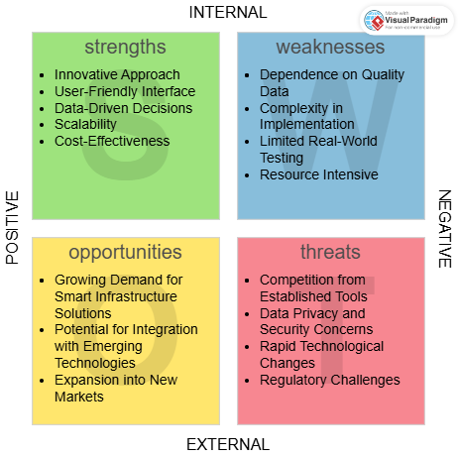
SWOT Analysis
SWOT Summary: The project leverages innovative route optimization for navigation applications, offering a user-friendly, data-driven solution. However, challenges include dependence on high-quality data and competition from established tools, which may impact its adoption and effectiveness.

Slide 9
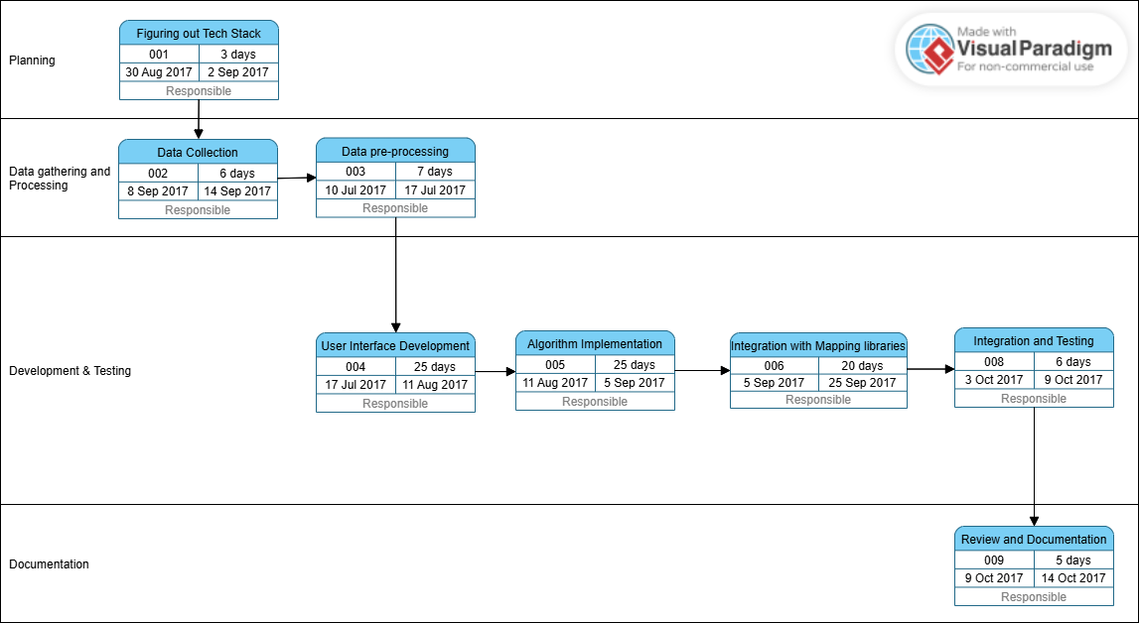

Pert Chart

Slide 10
References
https://docs.mapbox.com/help/glossary/mapbox-js/
Google Maps Platform. (n.d.). Google Maps API Documentation.
Project Management Institute. (2017). A Guide to the Project Management Body of Knowledge (PMBOK Guide) (6th ed.).
https://www.youtube.com/watch?v=J7eyI1ClDOA
https://www.iirs.gov.in/iirs/sites/default/files/pdf/2023/Overview_of_Remote_Sensing_and_GIS_Applications_E-Book.pdf
https://www.sciencedirect.com/journal/isprs-journal-of-photogrammetry-and-remote-sensing

